Slide 1
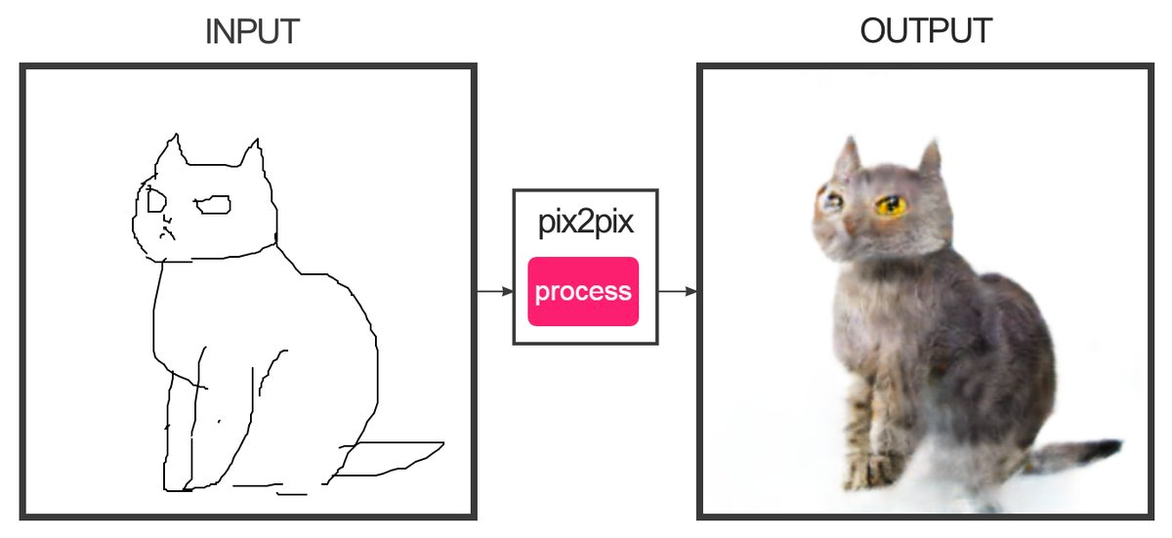
Conditional GANs, Image-to-Image Translation
Jun-Yan Zhu 16-726, Spring 2021
© https://affinelayer.com/pixsrv/, pix2pix [Isola et al., 2016]

Slide 2
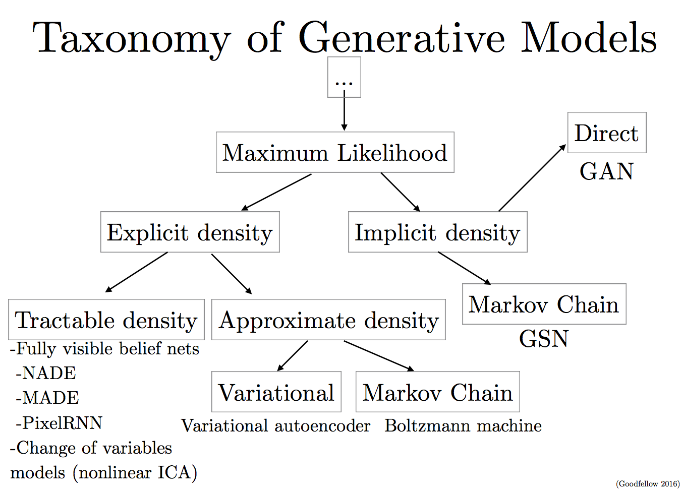
Review

Slide 3
Ideal models (Dream)
Pros: good sample, fast sample, Exact/fast likelihoods
good coverage, easy/fast to training, learn low-dimensional latent representation.
Cons: no cons
Autoregressive models
Pros: Exact likelihoods, good coverage
Cons: Slow to evaluate or sample
VAEs
Pros: Cheap to sample, good coverage
Cons: Blurry samples (in practice)
GANs
Pros: Cheap to sample, fast to train, good samples
Cons: No likelihoods (density), bad coverage (mode collapse)
Flow-based models
Pros: Cheap to sample, exact likelihoods
Cons: memory-intensive; slow training; limited choices for generators,
high-dimensional codes
[adapted from Phillip Isola and David Duvenaud]

Slide 4

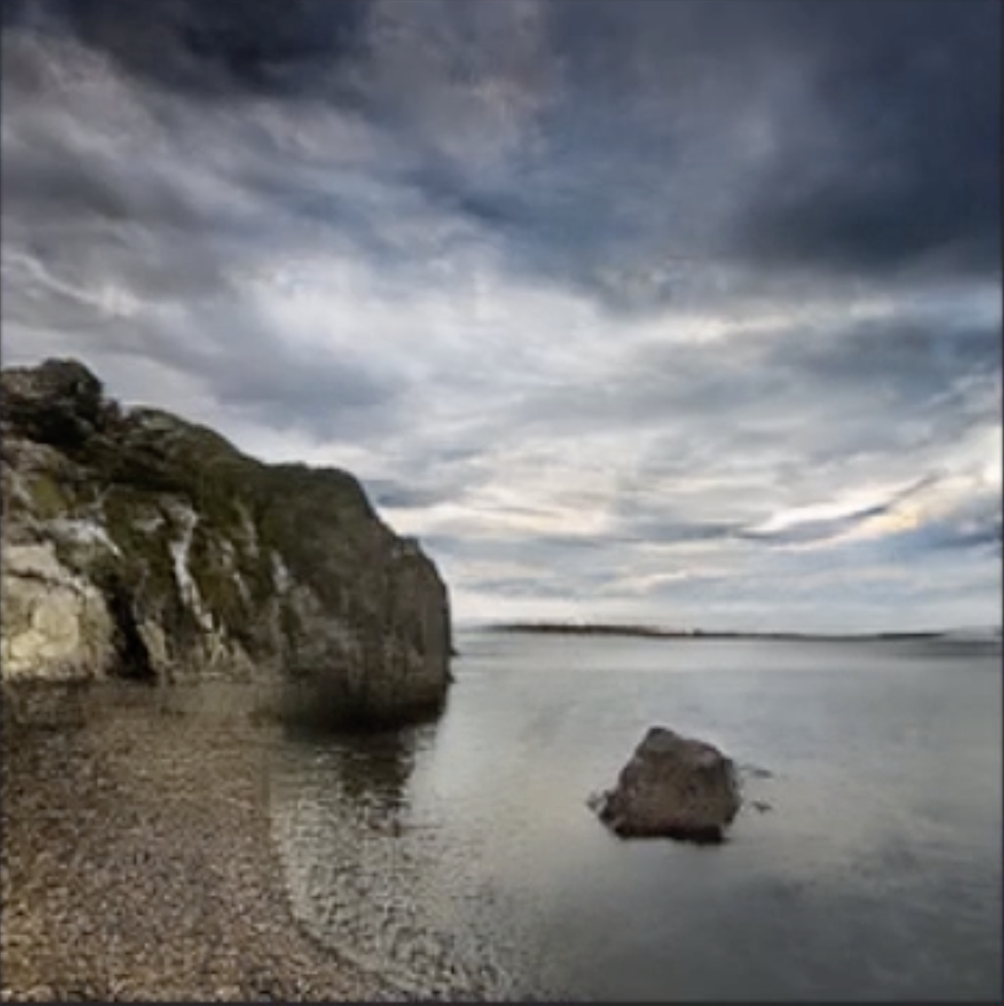
Problem Statement
Sky
mountain
sea
rock
Input
Output
Goal: synthesize a photograph given an input image

Slide 5
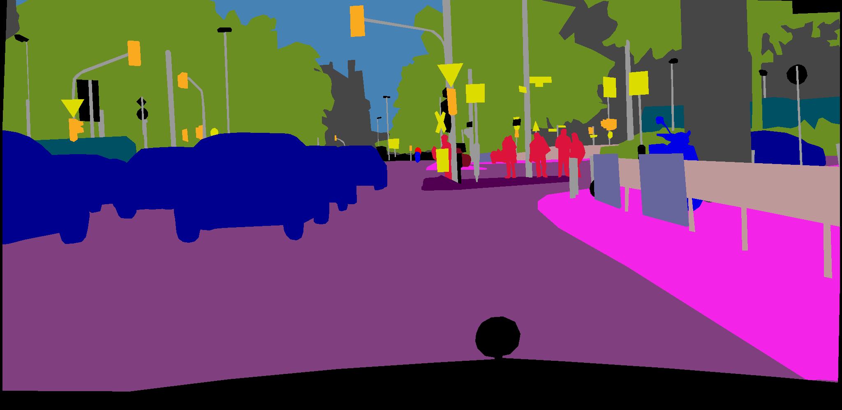
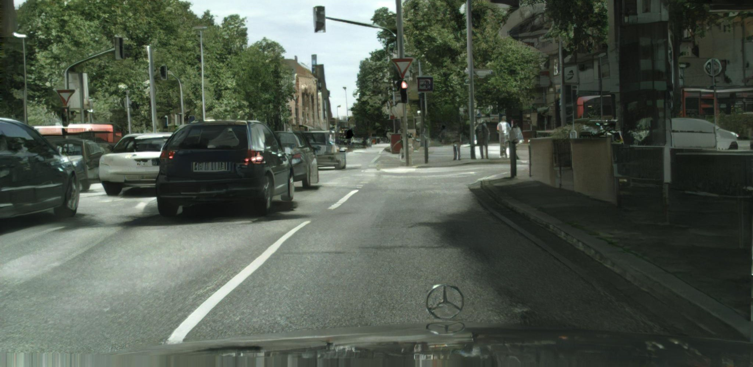
Problem Statement
Tree
Car
Road
Input
Output
Goal: synthesize a photograph given an input image

Slide 6
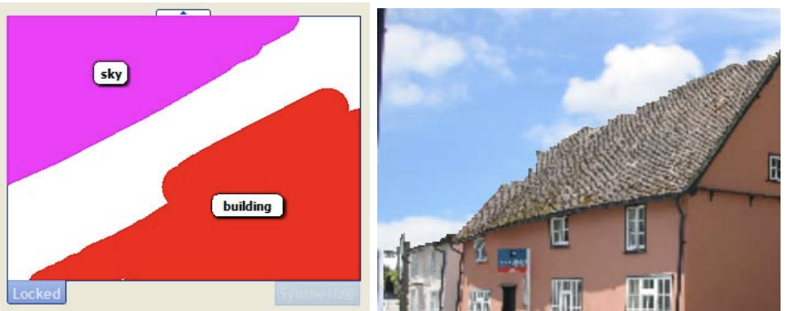
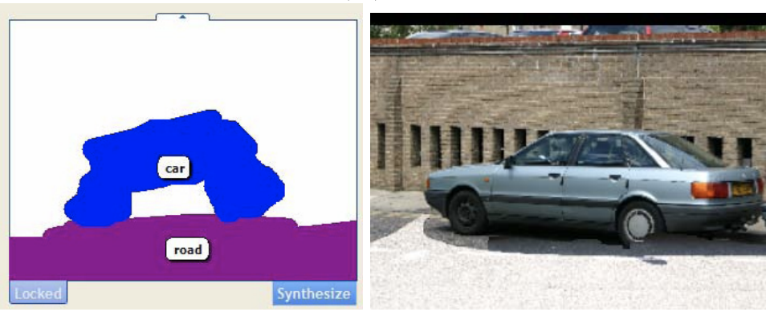
Seminal work (Example-based)
Semantic Photo Synthesis [Johnson et al., Eurographics 2006]
Sketch2Photo [Tao et al., SIGGRAPH Asia 2009]

Slide 7
Semantic Photo Synthesis
Huge Dataset
image
matching
Image Content from Similar Images
Image description
Images
Associated Info
M. Johnson, G. Brostow, J. Shotton, O. A. c, and R. Cipolla, “Semantic Photo Synthesis,” Eurographics 2006

Slide 8
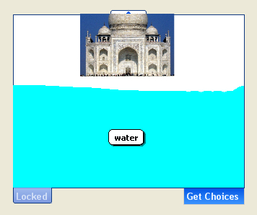

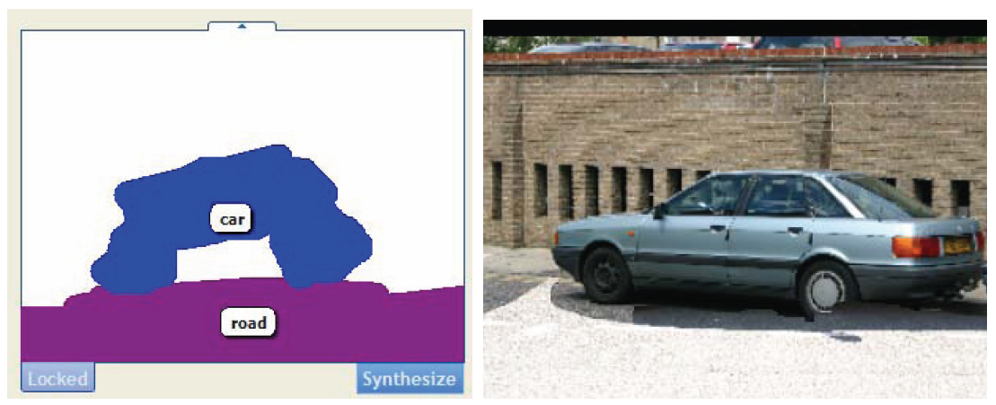
Semantic Photo Synthesis [EG’06]
M. Johnson, G. Brostow, J. Shotton, O. A. c, and R. Cipolla, “Semantic Photo Synthesis,” Eurographics 2006

Slide 9
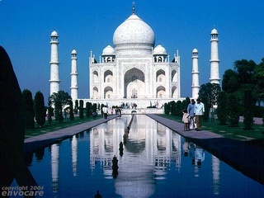
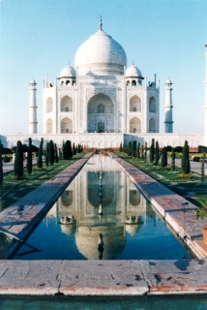
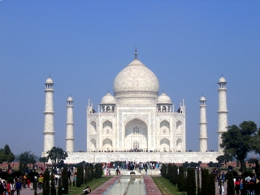
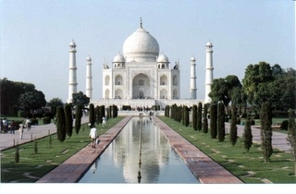

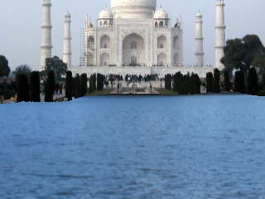
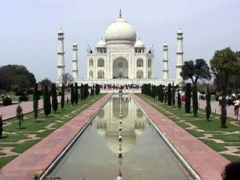
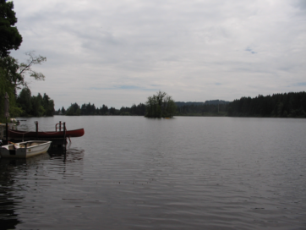
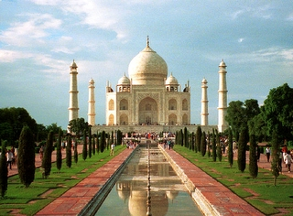

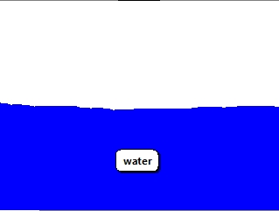
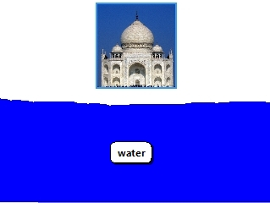

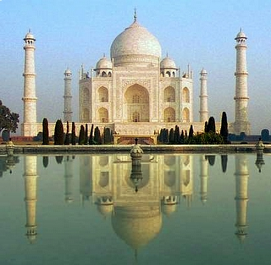
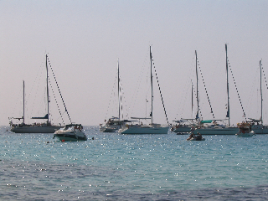
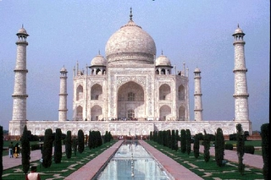
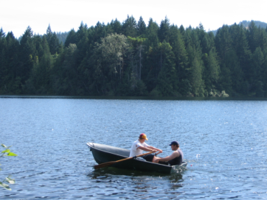
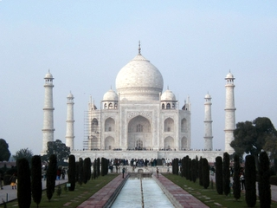
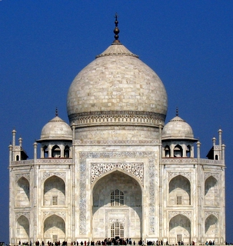

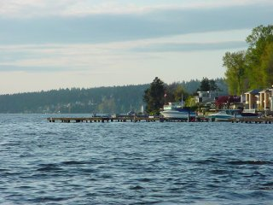
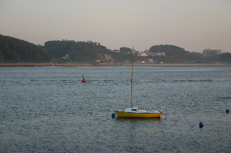
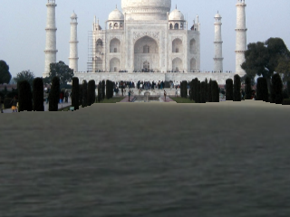
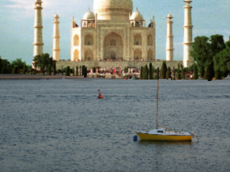
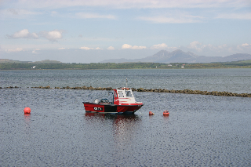

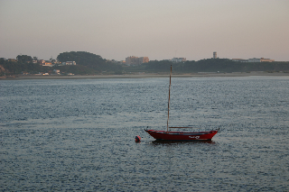
Semantic Photo Synthesis
1
2
3
4

Slide 10
Semantic Photo Synthesis
Huge Dataset
image
matching
Image Content from Similar Images
Image description
Images
Associated Info
M. Johnson, G. Brostow, J. Shotton, O. A. c, and R. Cipolla, “Semantic Photo Synthesis,” Computer Graphics Forum Journal (Eurographics 2006), vol. 25, no. 3, 2006.

Slide 11
Learning-based methods

Slide 12
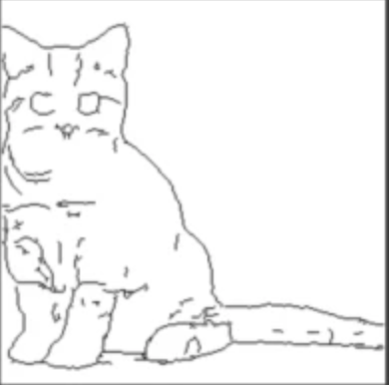

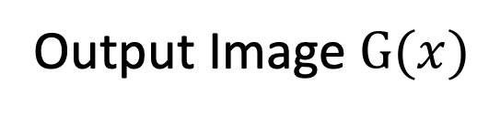
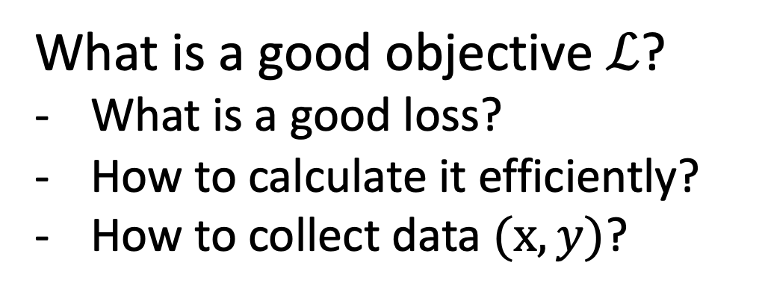
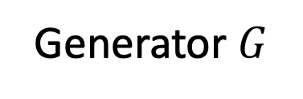

Loss functions for Image Synthesis
Generator$G$
Input $x$
Learnable rendering
Output Image $G(x)$
What is a good objective $ℒ$?
What is a good loss?
How to calculate it efficiently?
How to collect data $(x, y)$?
Problem Statement
Loss function
Generator
Input Info
Output image

Slide 13

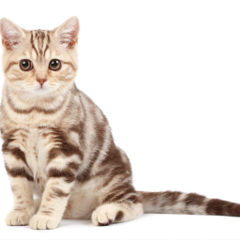
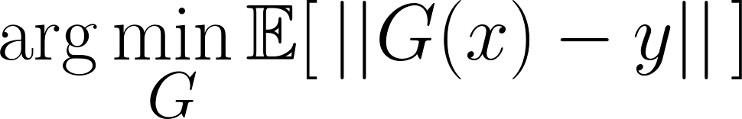

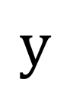
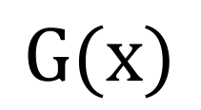




Designing Loss Functions
$$x$$
$$G(x)$$
$$y$$
$$|$$
$$−$$
$$|$$
$$G$$
Input
Generator
Predicted output
GT output
L2 regression

Slide 14
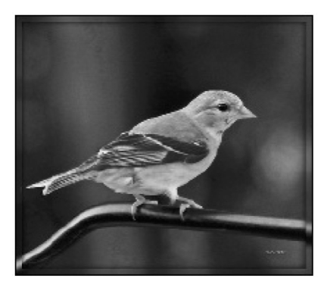
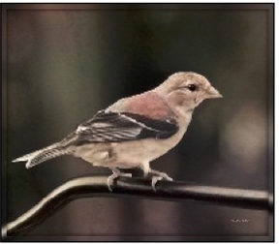
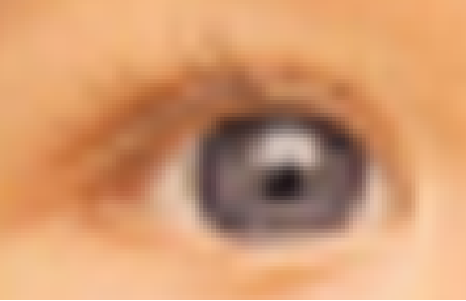
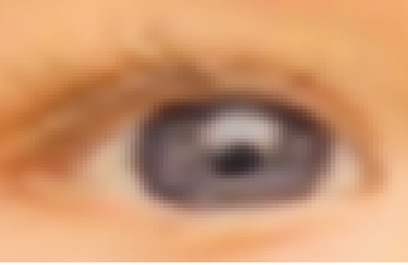
Designing Loss Functions
Image colorization
L2 regression
Super-resolution
L2 regression

Slide 15
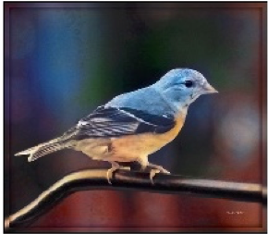
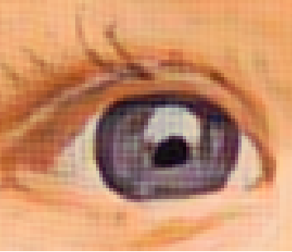
Designing Loss Functions
Image colorization
Classification Loss:
Cross entropy objective, with colorfulness term
[Zhang et al. 2016]
Super-resolution
Feature/Perceptual loss
Deep feature matching objective
[Gatys et al., 2016], [Johnson et al. 2016], [Dosovitskiy and Brox. 2016]

Slide 16
“Perceptual Loss”
Gatys et al. In CVPR, 2016.
Johnson et al. In ECCV, 2016.
Dosovitskiy and Brox. In NIPS, 2016.
Chen and Koltun. In ICCV, 2017.

Slide 17


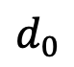
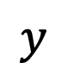
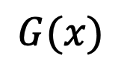
CNNs as a Perceptual Metric
Normalize, Subtract
L₂ norm,
Spatial average
Avg
$$F$$
$$F$$
$$d_{0}$$
$$G(x)$$
$$y$$
c.f. Gatys et al. CVPR 2016. Johnson et al. ECCV 2016. Dosovitskiy and Brox. NIPS 2016.

Slide 18
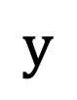
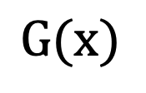




CNNs as a Perceptual Metric
$$x$$
$$G(x)$$
$$y$$
$$|F($$
$$)−F($$
$$)|$$
$$G$$
Input
Generator
Predicted output
GT output
F is a deep network (e.g., ImageNet classifier)
Perceptual Loss
weight
(i)-th layer
The number of elements in the (i)-th layer

Slide 19
Learning with Perceptual Loss
Input
Output
Training objective:
CRN [Chen and Koltun, 2017]

Slide 20


Generated images
Universal loss?
…
…

Slide 21



Generated images
Generative Adversarial Network
(GANs)
…
…
Classifier
Real vs. Fake
Real photos
…
[Goodfellow, Pouget-Abadie, Mirza, Xu, Warde-Farley, Ozair, Courville, Bengio 2014]

Slide 22



$$x$$
$$G(x)$$
$$G$$
Input image
Generator
Output image
[Goodfellow et al. 2014]

Slide 23


$$x$$
$$G(x)$$
$$G$$
$$D$$
Real (1) or fake (0)?
Input image
Generator
Output image
Discriminator
A two-player game:
$G$ tries to generate fake images that can fool $D.$
$D$ tries to detect fake images.
[Goodfellow et al. 2014]

Slide 24

$$x$$
$$G(x)$$
$$G$$
$$D$$
fake (0.1)
Input image
Generator
Output image
Discriminator
Learning objective
[Goodfellow et al. 2014]

Slide 25


$$x$$
$$G(x)$$
$$G$$
$$D$$
fake (0.1)
Input image
Generator
Output image
Discriminator
$$x$$
Learnable Loss function
$$D$$
real (0.9)
real image
Learning objective
[Goodfellow et al. 2014]

Slide 26

$$x$$
$$G(x)$$
$$G$$
$$D$$
fake (0.5)
Input image
Generator
Output image
Discriminator
$$x$$
Learnable Loss function
$$D$$
real (0.9)
real image
Learning objective
[Goodfellow et al. 2014]

Slide 27
$$x$$
$$G(x)$$
$$G$$
$$D$$
Real✓
Input image
Generator
Output image
Discriminator
Learning objective
Pix2pix [Isola et al., 2016]

Slide 28



$$x$$
$$G(x)$$
$$G$$
$$D$$
Real too✓
Input image
Generator
Output image
Discriminator
Learning objective
Pix2pix [Isola et al., 2016]

Slide 29

$$x$$
$$G(x)$$
$$G$$
Generator
$$D$$
Real or fake pair ?
Discriminator
Learning objective
Pix2pix [Isola et al., 2016]

Slide 30



#edges2cats
[Christopher Hesse]
@gods_tail
@matthematician
Vitaly Vidmirov @vvid
Ivy Tasi @ivymyt
https://affinelayer.com/pixsrv/

Slide 31







$$x$$
$$G(x)$$
$$G$$
Generator
$$D$$
Real or fake pair ?
Discriminator
Input: Sketch $→$ Output: Photo
Input: Grayscale $→$ Output: Color

Slide 32












Automatic Colorization with pix2pix
Input
Output
Input
Output
Input
Output
Data from [Russakovsky et al. 2015]

Slide 33


Slide 34

The Curse of Dimensionality
Tree
Building
Car
Road
Sidewalk
Pix2pix output

Slide 35





pix2pixHD
Low-res
Discriminator
$$D_{1}$$
Real/fake?
$$G_{1}$$
Low-res
Generator
$$G_{2}$$
High-res
Generator
$$D_{2}$$
Real/fake?
Image Pyramid [Burt and Adelson, 1987]
Also see [Zhang et al., 2017]
[Karras et al., 2018]
High-res
Discriminator
Coarse-to-fine
pix2pixHD [Wang et al., 2018]

Slide 36
pix2pixHD: 2048$×$1024
Tree
Building
Car
Road
Sidewalk

Slide 37


Slide 38


Semantic Photo Synthesis in the Wild
pix2pixHD [Wang et al., 2018]

Slide 39



somehow show that the semantic information is lost
input
output
sky
grass
pix2pixHD [Wang et al., 2018]

Slide 40







somehow show that the semantic information is lost
Problem with standard networks
conv
normalization
rock, water, moss, …

Slide 41





somehow show that the semantic information is lost
Problem with standard networks
conv
normalization
grass

Slide 42
normalization
normalization
normalization

Slide 43


somehow show that the semantic information is lost
input
output
sky
grass
SPADE (ours)

Slide 44


SPADE(SPAtially ADaptive DEnormalization)
$$β$$
conv
conv
conv
$$γ$$
Parameter-free Batch Norm
element-wise

Slide 45

SPADE(SPAtially ADaptive DEnormalization)
Batch Norm (Ioffe et al. 2015)
$$y=\frac{x−μ}{σ}⋅γ+β$$
affine transform
normalization
See other adaptive/conditional normalization: conditional BN (Dumoulin et al.),
AdaIN (Huang and Belongie), SFT (Wang et al.)

Slide 46

Generator
~
SPADE
ResBlk
SPADE
ResBlk
SPADE
ResBlk
SPADE
ResBlk

Slide 47


Semantic Control
SPADE
ResBlk
SPADE
ResBlk
SPADE
ResBlk
SPADE
ResBlk

Slide 48


Semantic Control
SPADE
ResBlk
SPADE
ResBlk
SPADE
ResBlk
SPADE
ResBlk

Slide 49


Semantic Control
SPADE
ResBlk
SPADE
ResBlk
SPADE
ResBlk
SPADE
ResBlk

Slide 50
Style Control
SPADE
ResBlk
SPADE
ResBlk
SPADE
ResBlk
SPADE
ResBlk

Slide 51

Style Control
SPADE
ResBlk
SPADE
ResBlk
SPADE
ResBlk
SPADE
ResBlk
Style Manipulation

Slide 52

Style Control
SPADE
ResBlk
SPADE
ResBlk
SPADE
ResBlk
SPADE
ResBlk
Style Manipulation

Slide 53

SIGGRAPH 2019 Real-time Live! “Best of Show Award" and "Audience Choice Award"

Slide 54
By Darek Zabrocki, Concept Designer and Illustrator

Slide 55
Learning vs. Exemplar-based

Slide 56

Exemplar-based method
Shape and Context [Bansal et al., 2019]

Slide 57

Hybrid Method
Output from
exemplar-based method
Semi-Parametric Image Synthesis [Qi et al., 2018]

Slide 58



Learning-based
Hybrid method
Exemplar-based
[Isola et al], [Wang et al]
[Park et al], SEAN [Zhu et al]
SIMS [Qi et al]
[Johnson et al], [Lalonde et al]
[Tao et al], [Bansal et al]
Speed
Local realism
Global realism
Match Input

Slide 59
Discussion
Summary
Intuitive user inputs.
Realistic outputs.
Used by visual artists.
Challenges
Fine-grained controls (texture, 3D, and lighting).
High-resolution output (4K).
Model efficiency on mobile devices.
Video Control.

Slide 60

Thank You!
16-726, Spring 2021
https://learning-image-synthesis.github.io/
© murtaugh

